Slide 1
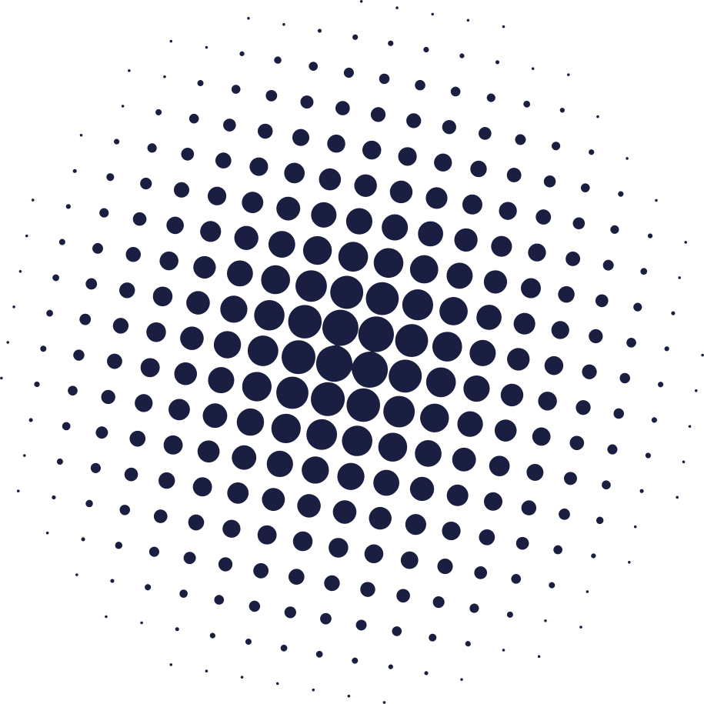

THE WORLD OF GAMES
An Interactive Game Platform for Learning Computer Graphics

Slide 2

INTERNATIONAL ISLAMIC UNIVERSITY CHITTAGONG
INTERNATIONAL ISLAMIC UNIVERSITY CHITTAGONG
DEPARTMENT OF COMPUTER SCIENCE & ENGINEERING
Computer Graphics Lab
CSE-4742
PRESENTED BY
PRESENTED TO
REHNUMA TASNEEM_C223288
SAIMA KAWSAR_C223297
SULTANA TASNIM JAHAN
Lecturer
CSE,IIUC

Slide 3

INTRODUCTION
Gaming World is a desktop‑based graphical application.
It combines three popular games(Tic Tac Toe, Candy Crush, Tetris) into one platform.
The project is developed using C++ and OpenGL.
Focuses on graphics rendering, animation, and user interaction.

Slide 4
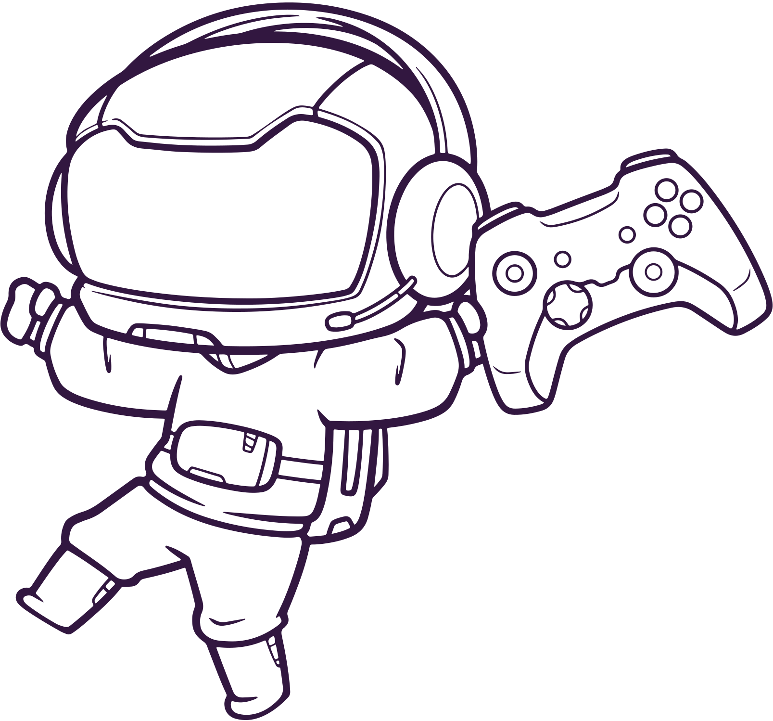
OBJECTIVES
To learn OpenGL graphics programming
To design an interactive GUI‑based application
To implement game logic and animations
To integrate multiple games into one system

Slide 5
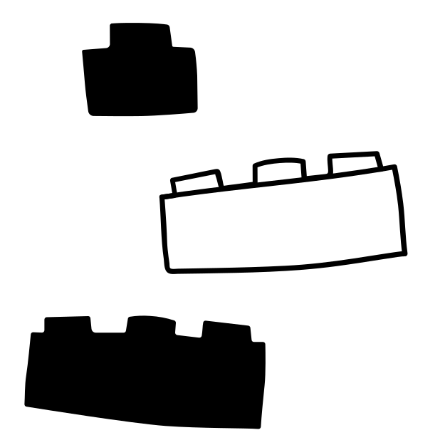
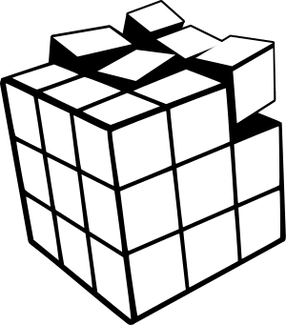
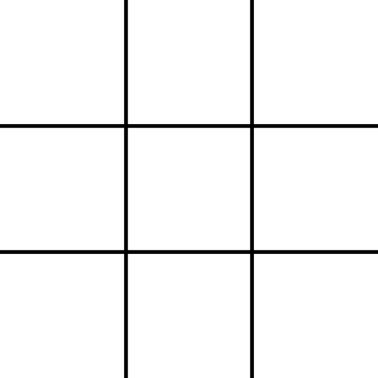


WHY WE CHOSE THIS PROJECT
Games make learning programming interesting and practical
Improves problem‑solving skills
Practical application of C++ and OpenGL
This project connects learning with fun and interaction
Helps understand real‑world use of graphics

Slide 6

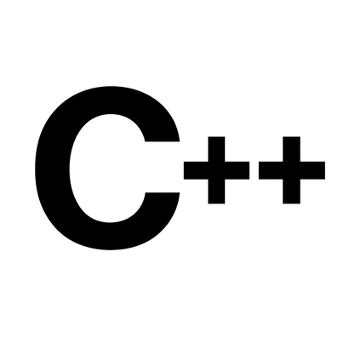

TOOLS & TECHNOLOGIES USED
Programming Language: C++
Graphics Library: OpenGL (GLUT)
IDE: Code::Blocks
OS: Windows

Slide 7
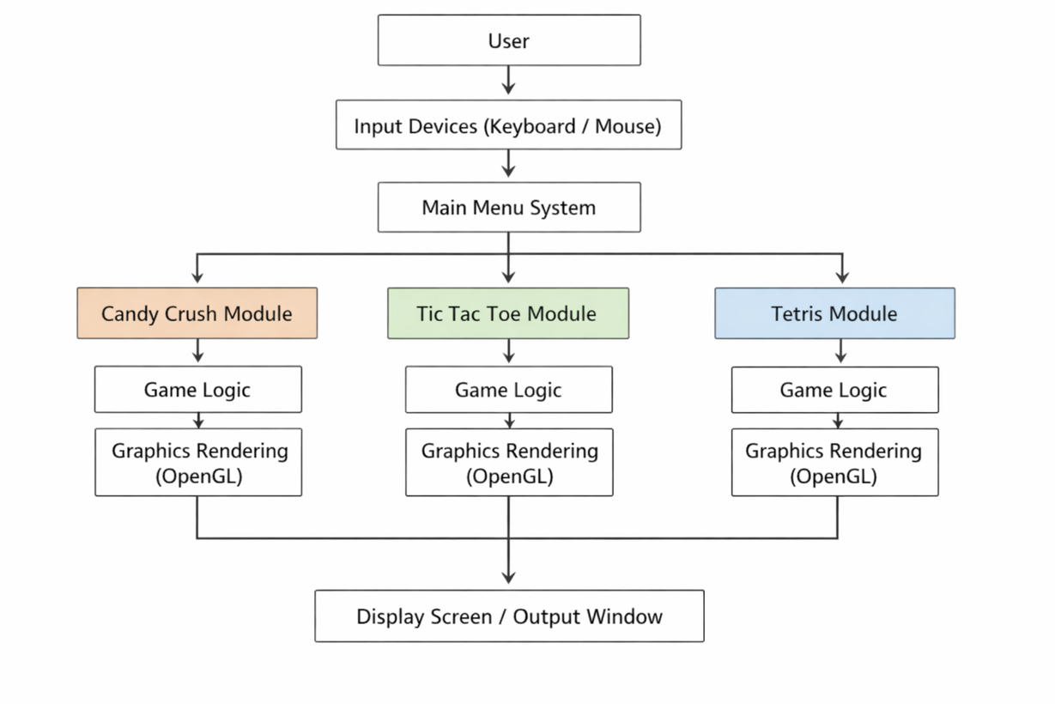
OVERALL SYSTEM ARCHITECTURE
Main Menu System
Game Selection using buttons
Separate modules for:
Candy Crush
Tic Tac Toe
Tetris
Common input handling system

Slide 8
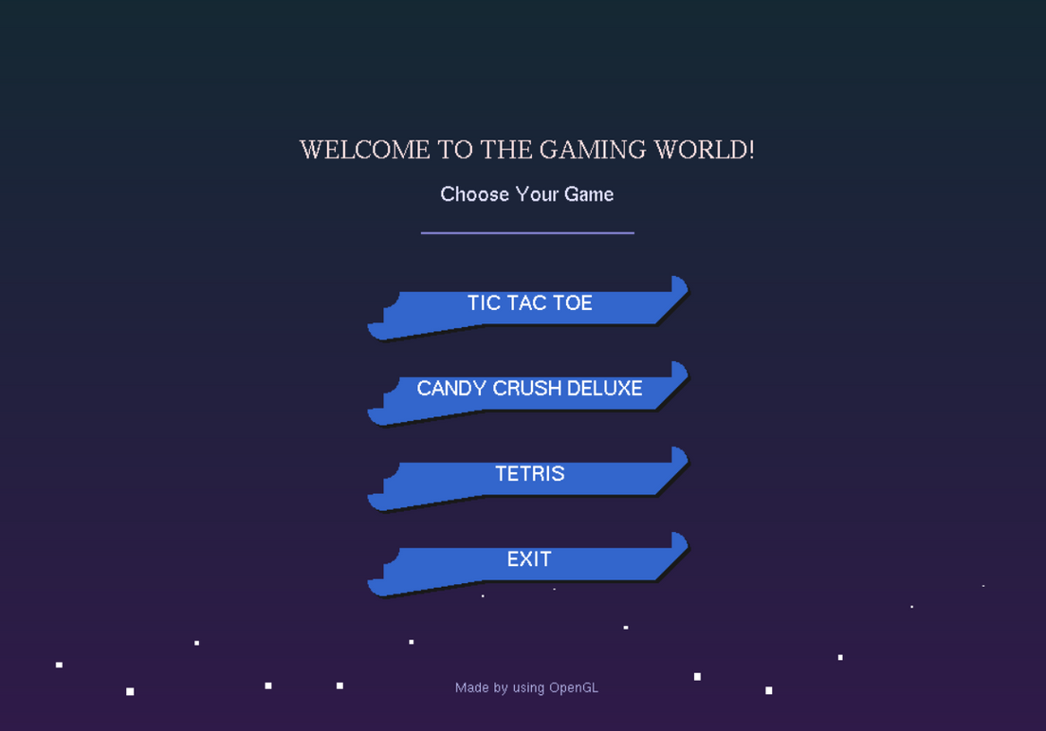
MAIN MENU FEATURES
Attractive animated background
Interactive buttons
Mouse hover effect
Easy navigation
Back to main menu option

Slide 9
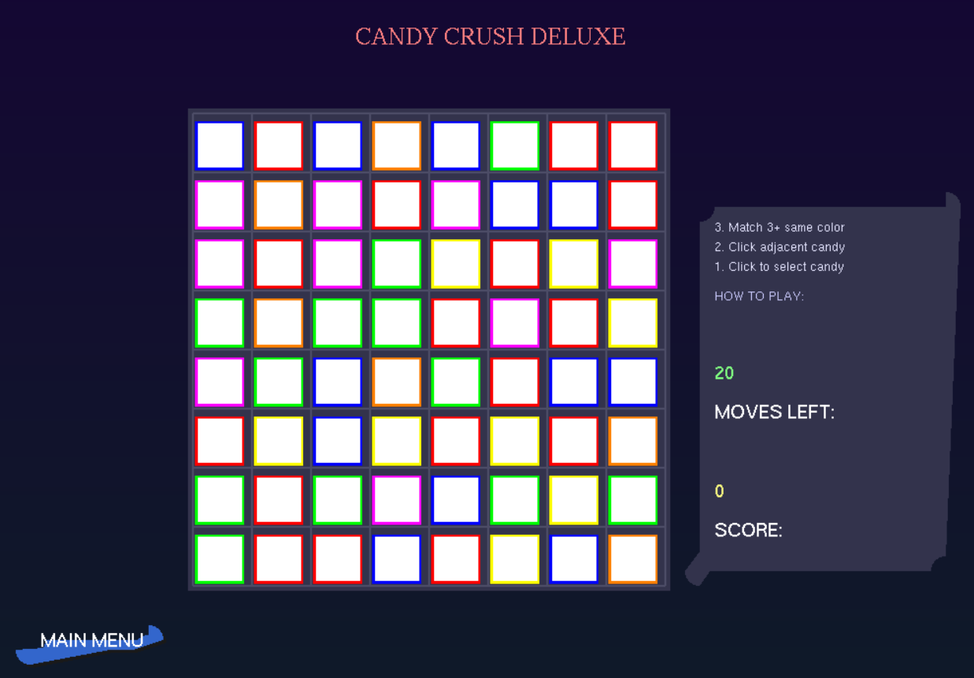
CANDY CRUSH GAME
Grid‑based puzzle game played on an 8×8 board
Goal is to match three or more same candies
Matched candies disappear and new candies fall from the top
The game tracks score and remaining moves

Slide 10
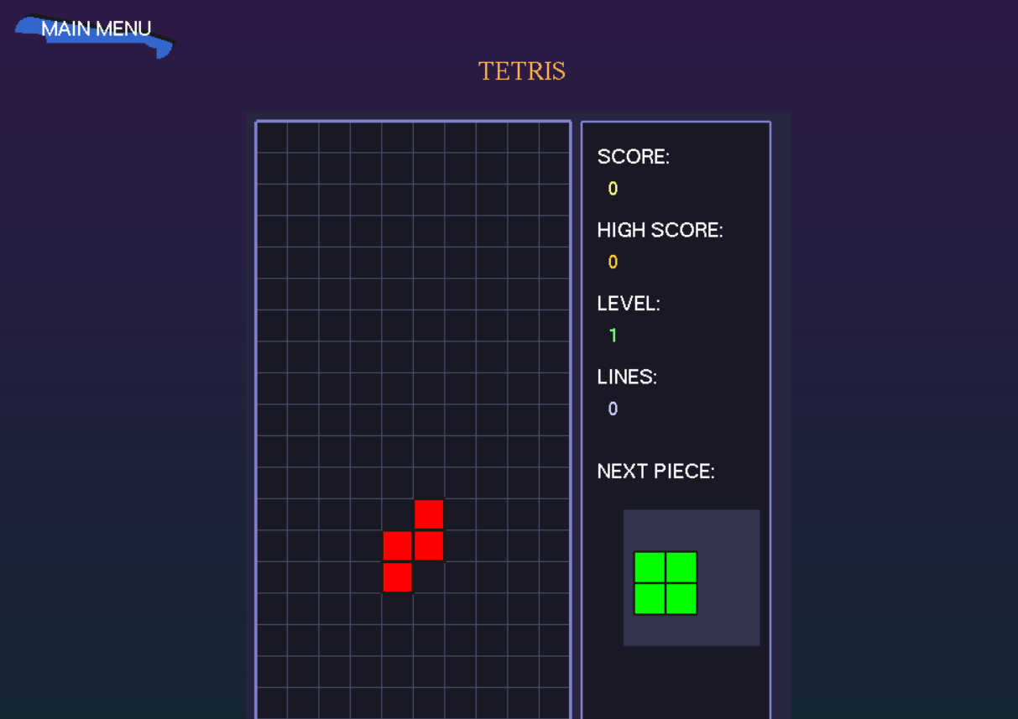
TETRIS GAME
Classic block‑falling game with different shapes
Goal is to complete horizontal lines
Completed lines are cleared and score increases
Game ends when blocks reach the top

Slide 11
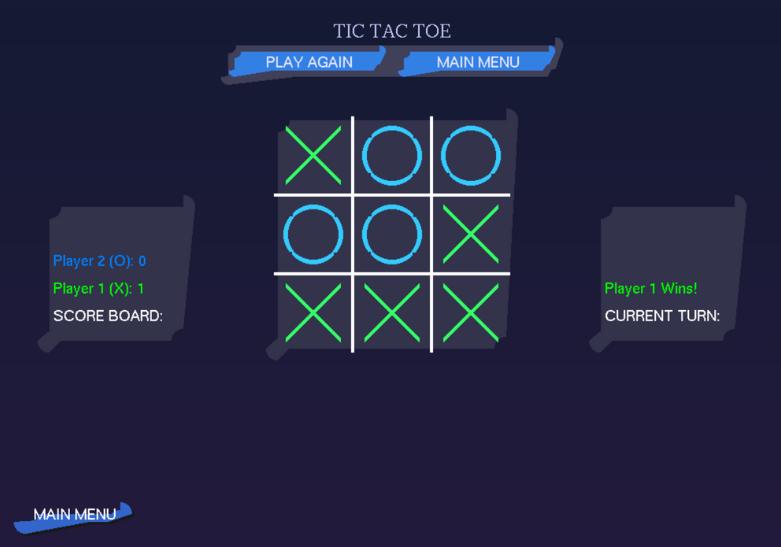
TIC TAC TOE GAME
Simple two‑player turn‑based game
Played on a 3×3 grid using X and O
Checks for win, draw, or ongoing state
Win occurs by completing a row, column, or diagonal

Slide 12
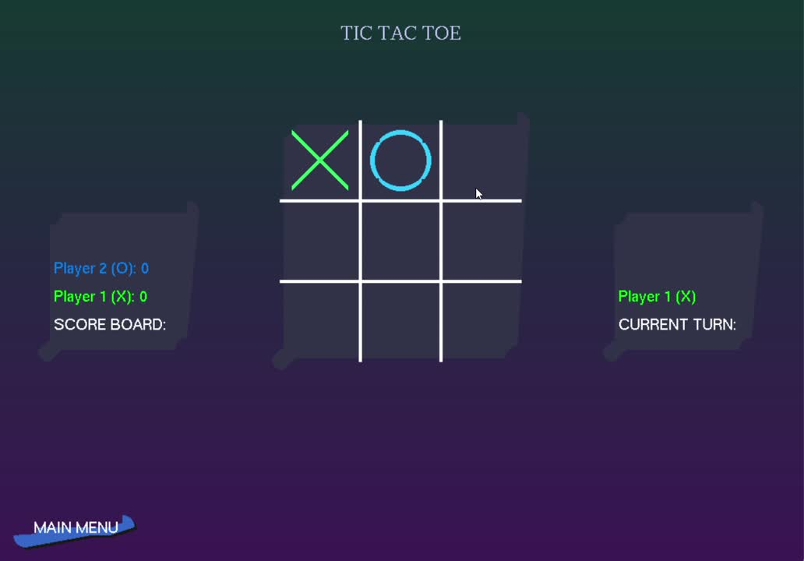
SNEAK PEEK

Slide 13




CHALLENGES FACED
Handling multiple game states
Collision detection in Tetris
Match logic in Candy Crush
Managing animations smoothly

Slide 14

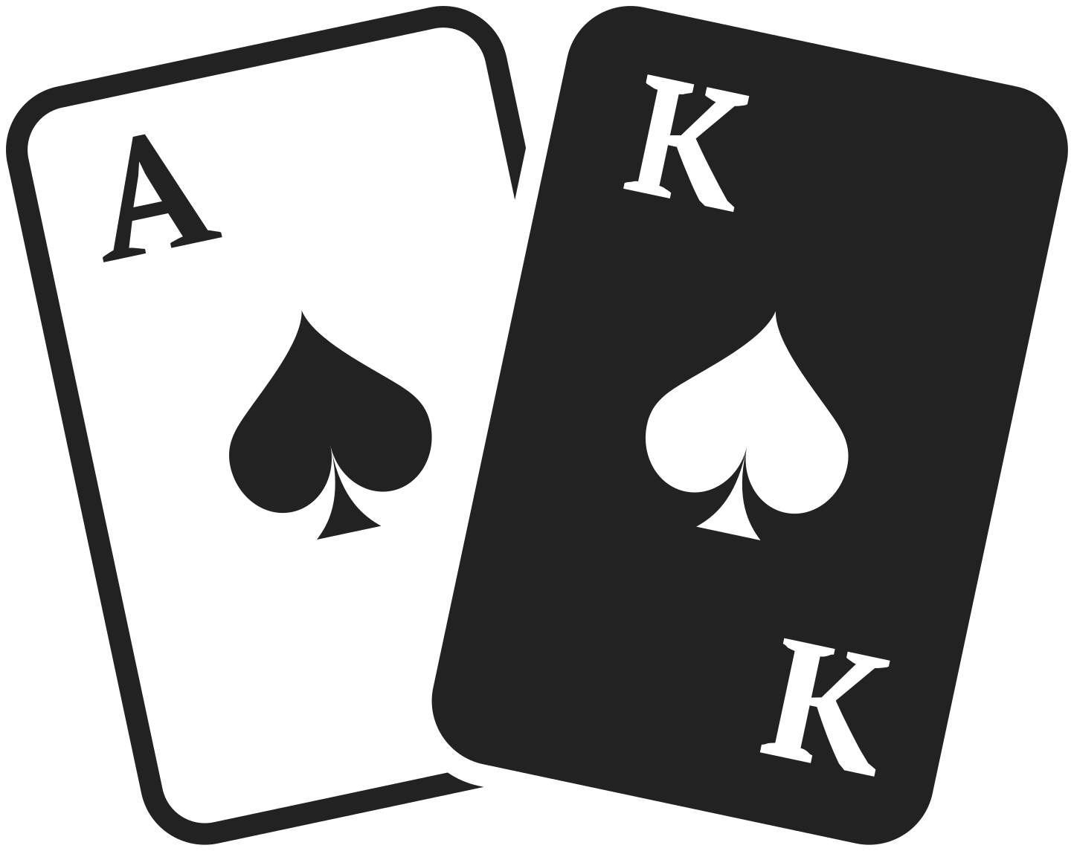
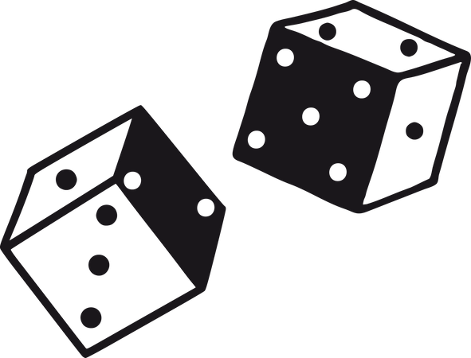
FUTURE IMPROVEMENTS
Add sound effects
Add more games
Improve graphics quality
Add AI for single‑player mode
Online multiplayer support

Slide 15

CONCLUSION
Successfully implemented a multi‑game system
Achieved all project objectives
Practical application of graphics concepts
Educational and enjoyable project

Slide 16

THANK YOU

